Slide 1
session5: visualise data in R

Slide 2
Content
Visualising Data in R with ggplot2
General data visualisation tips

Slide 3
What can data visualisation do ?
help you to explore & understand your data
communicate your data

Slide 4
Visualising data in R with ggplot2
There are many ways to plot graphs in R
Base R has visualisation commands
ggplot2 package allows you to ‘layer’ features of graphs
works well with tidy data
it is part of the tidyverse, load it now with
library(ggplot2) or library(tidyverse)
(called ggplot2 because the first version had problems! confusingly the main command is still called just ggplot )

Slide 5
Structure of a ggplot command
It takes a while to get used to the structure.
There are different forms of syntax.
Different syntax possible
But in general:
ggplot(data = date_frame_name) + style_of_plot(mapping = aes(x = column_name1, y = column_name2))
Notes:
This will become more clear once we see examples

Slide 6
ggplot is very versatile
You can use the same structure for many types of graphs.
ggplot(data = date_frame_name) + style_of_plot(mapping = aes(x = column_name1, y = column_name2)) + other_arguments
Notes:
Explain a couple of things you can add on using the + sign.

Slide 7
What is a ‘geom’?
A geom is a visual aspect of a graph.
dots
lines
bars
Look at the ggplot2 cheatsheet for more options.

Slide 8
Live code dot plot with geom_point

Slide 9
Let’s create a line graph together
ggplot(data = cchic) + geom_smooth(mapping = aes(x = wbc, y = crp))
Notes:
Get them to type this code in and draw the graph. The graph they should get is on the next slide.

Slide 10
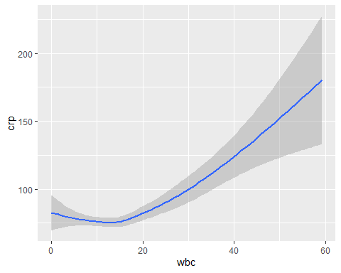

Slide 11
Adding a linetype
ggplot(data = cchic) + geom_smooth(mapping = aes(x = wbc, y = crp, linetype = sex))

Slide 12
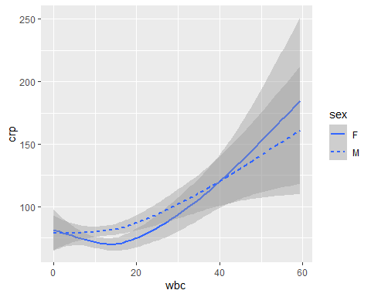

Slide 13
Adding colour
ggplot(data = cchic) + geom_smooth(mapping = aes(x = wbc, y = crp, colour = sex))

Slide 14
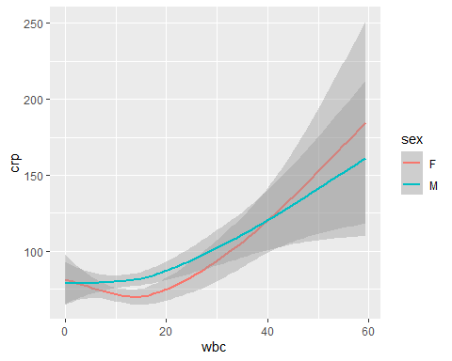

Slide 15
Combining multiple geoms
ggplot(data = cchic) + geom_point(mapping = aes(x = wbc, y = crp, colour = sex)) + geom_smooth(mapping = aes(x = wbc, y = crp))

Slide 16
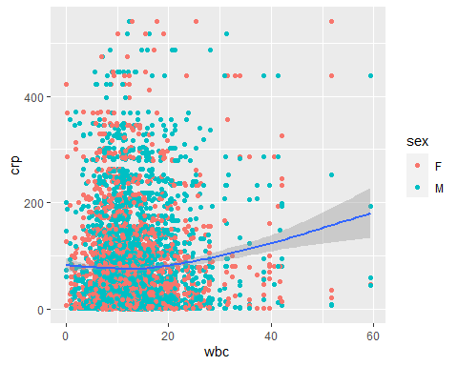

Slide 17
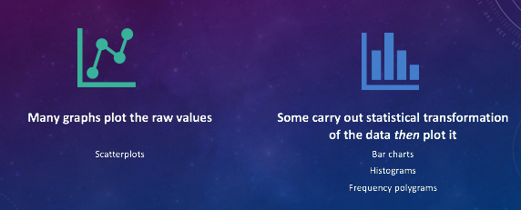
Bar Graph

Slide 18
Drawing a bar graph
geom_bar
ggplot(data = cchic) + geom_bar(mapping = aes(x = vital_status))

Slide 19
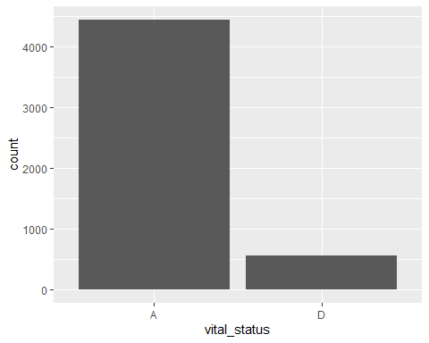

Slide 20
Proportion instead of count
ggplot(data = cchic) + geom_bar(mapping = aes(x = vital_status, y = ..prop.., group = 1))

Slide 21


Slide 22
Adding a second aesthetic
ggplot(data = cchic) + geom_bar(mapping = aes(x = vital_status, fill = sex))

Slide 23
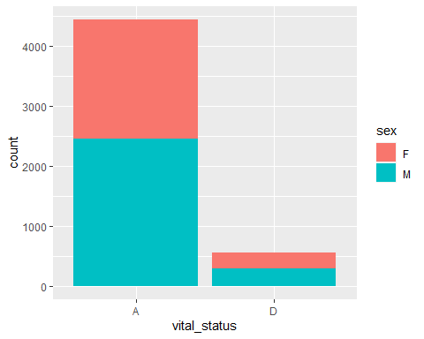

Slide 24
Standardising proportions
ggplot(data = cchic) + geom_bar(mapping = aes(x = vital_status, fill = sex), position = "fill")

Slide 25
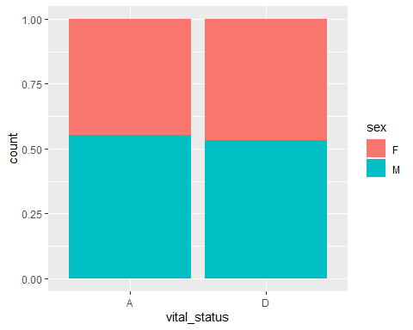

Slide 26
Changing position of bars
ggplot(data = cchic) + geom_bar(mapping = aes(x = vital_status, fill = sex), position = "fill")

Slide 28
Create your own plots now!

Slide 29
A few more general datavis guidelines to consider

Slide 30
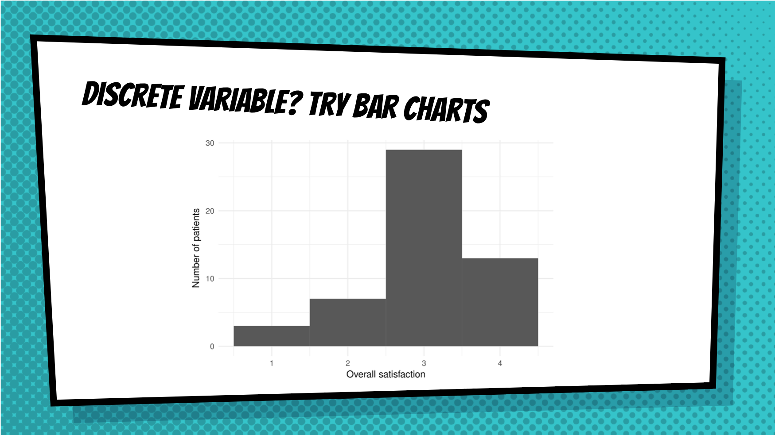

Slide 31
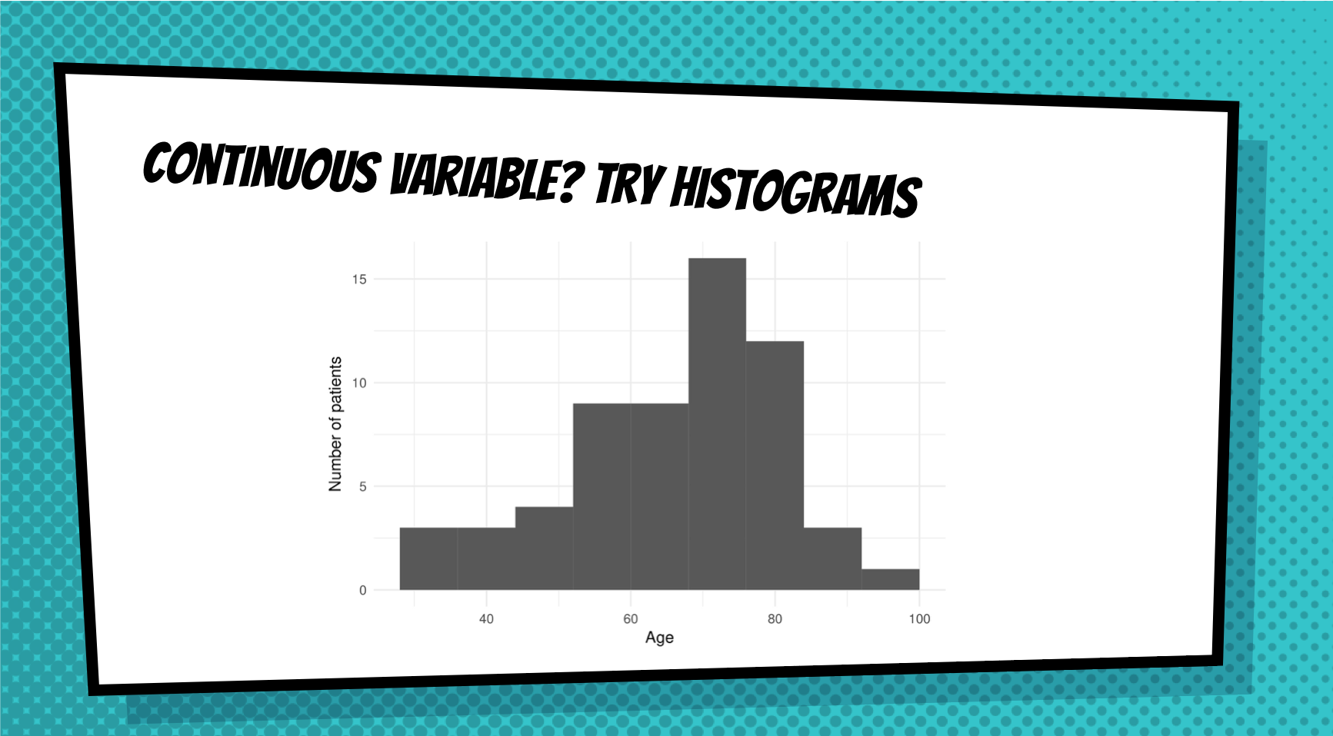

Slide 32
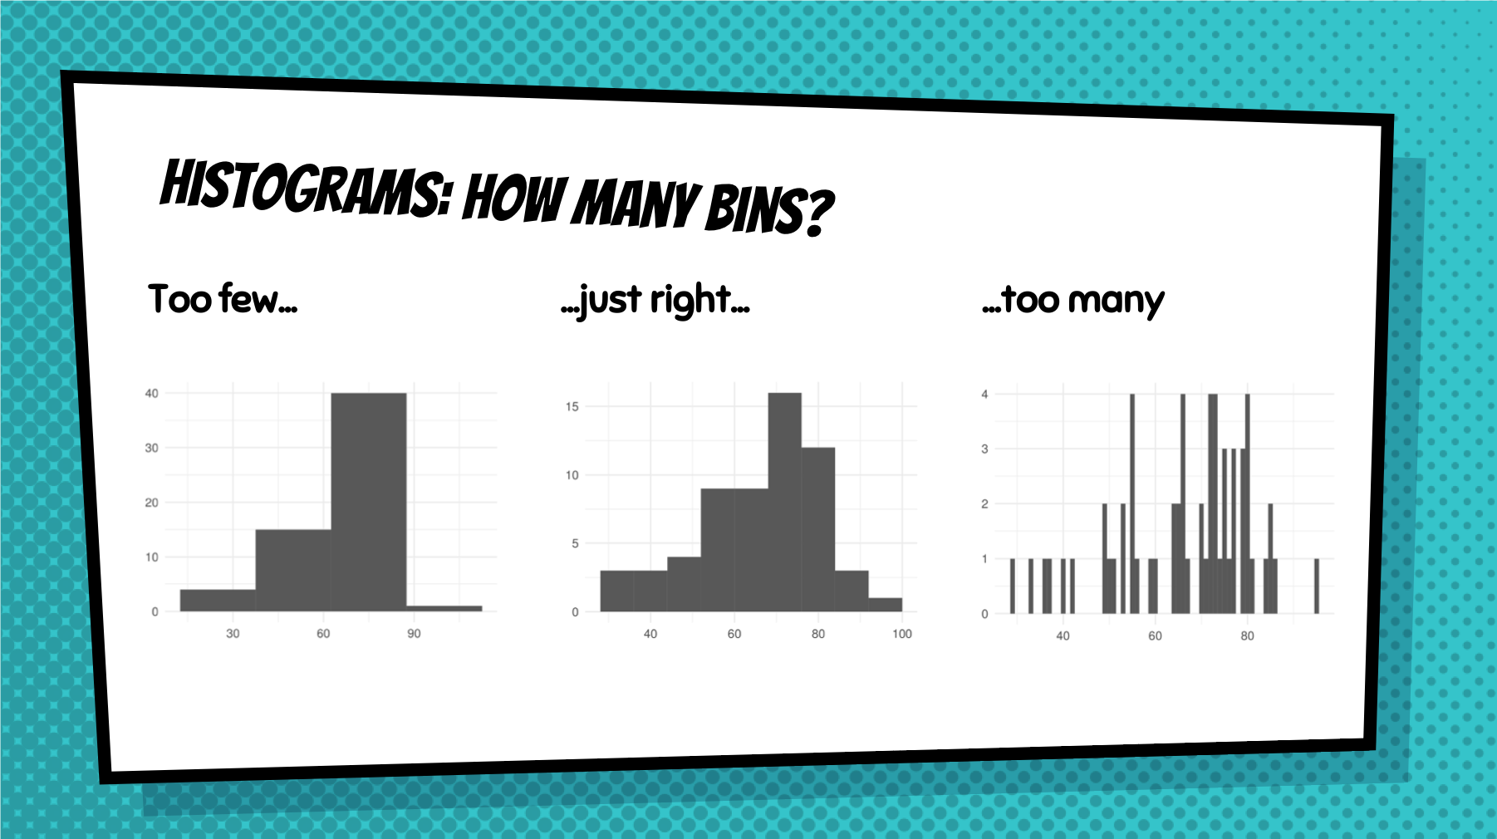

Slide 33
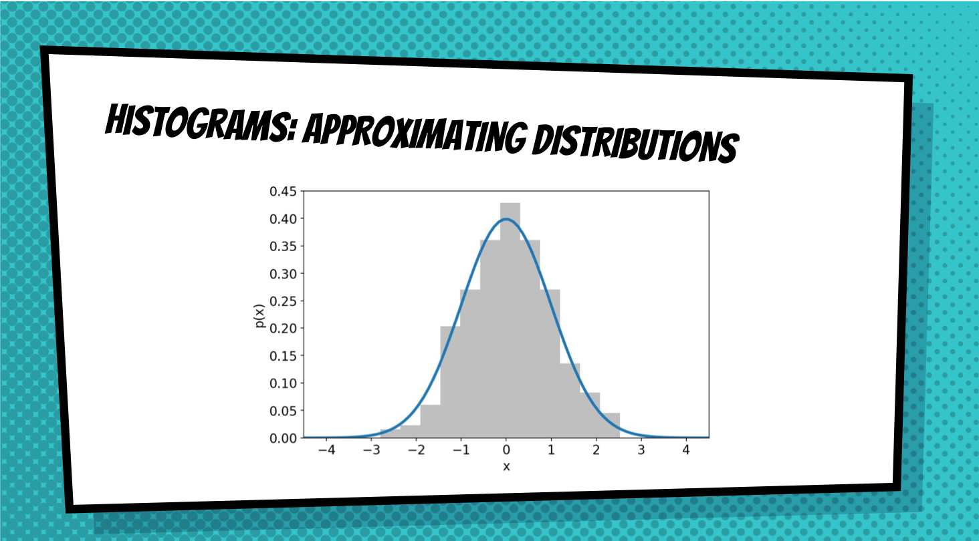

Slide 34
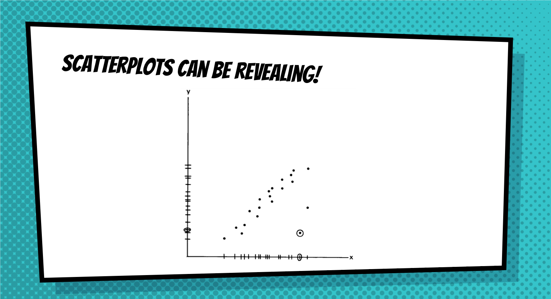

Slide 35


Slide 36
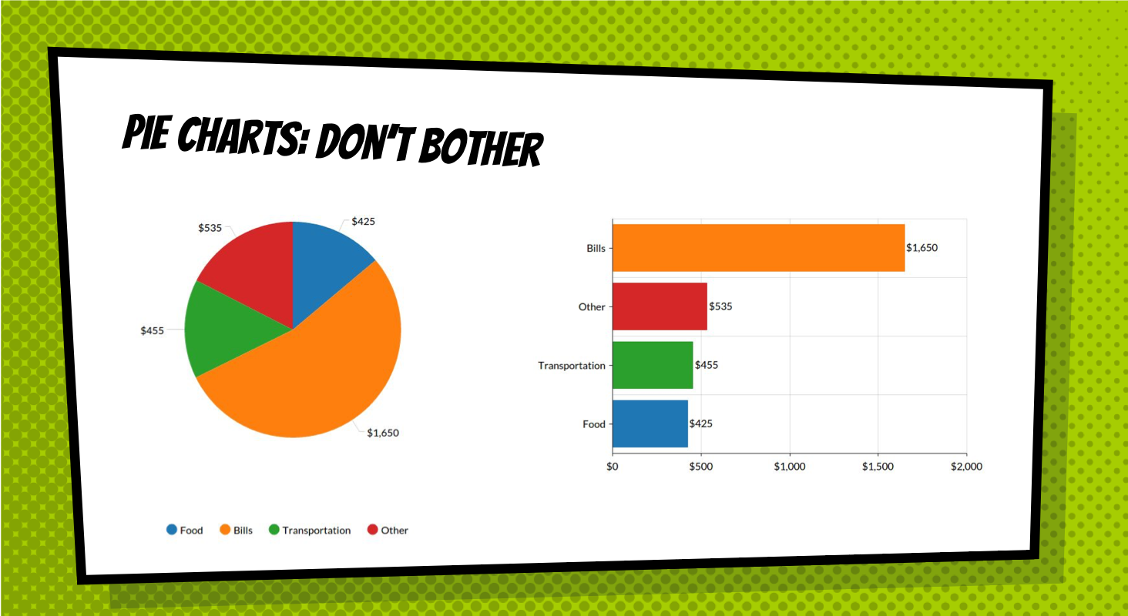

Slide 37
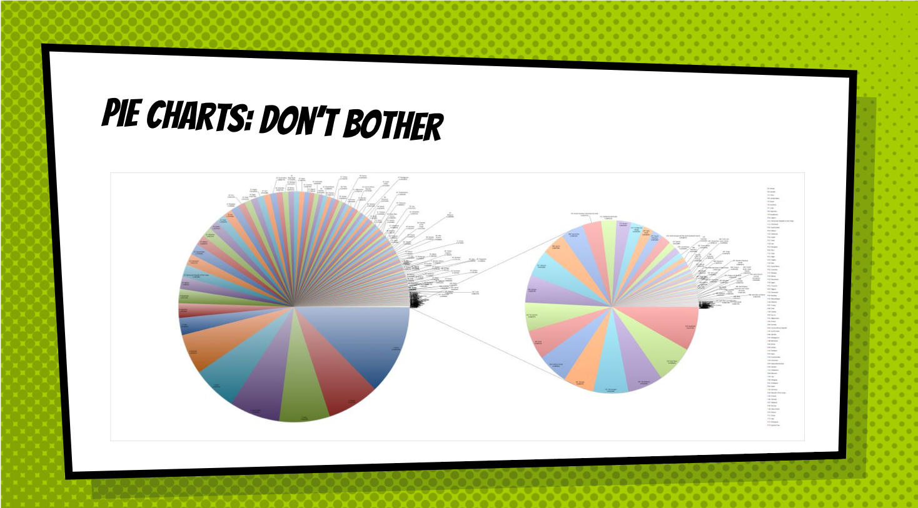

Slide 38
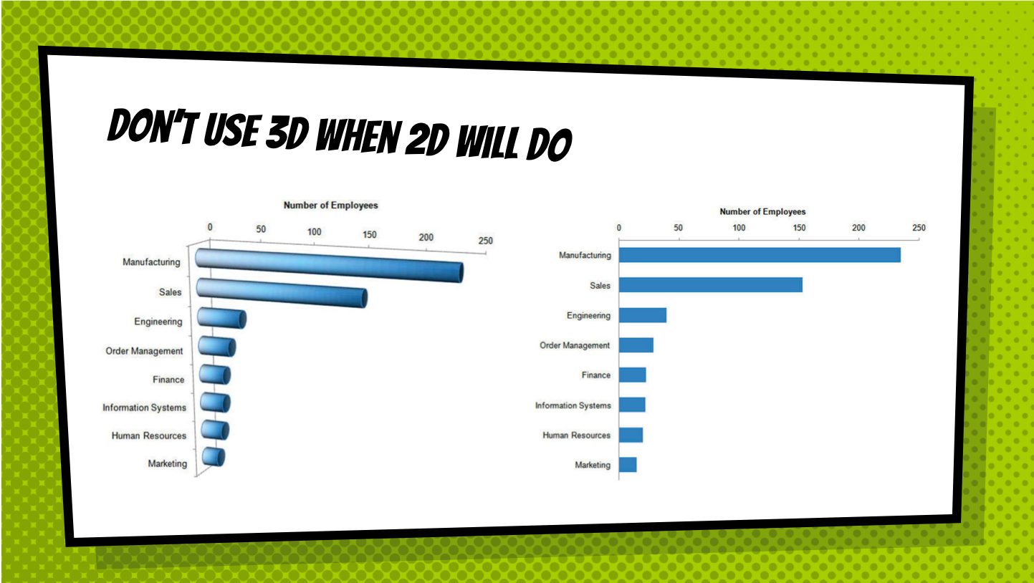

Slide 39
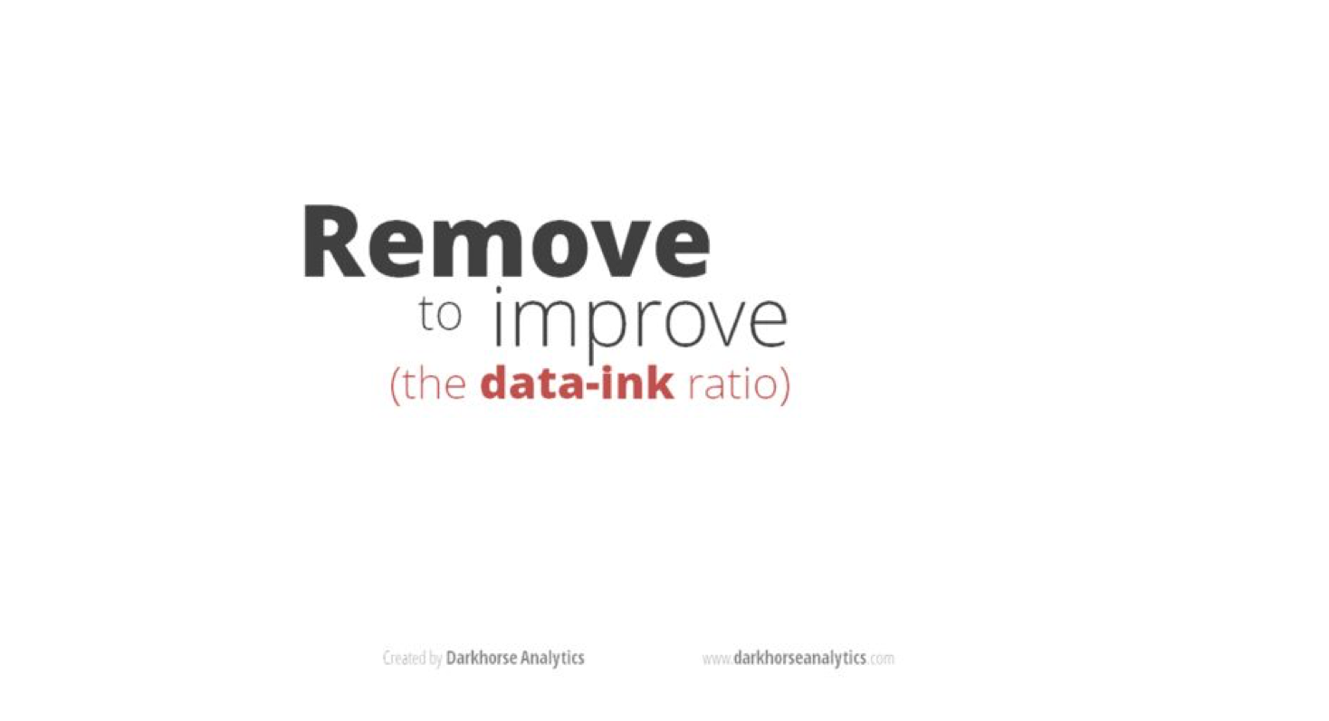

Slide 40


Slide 41
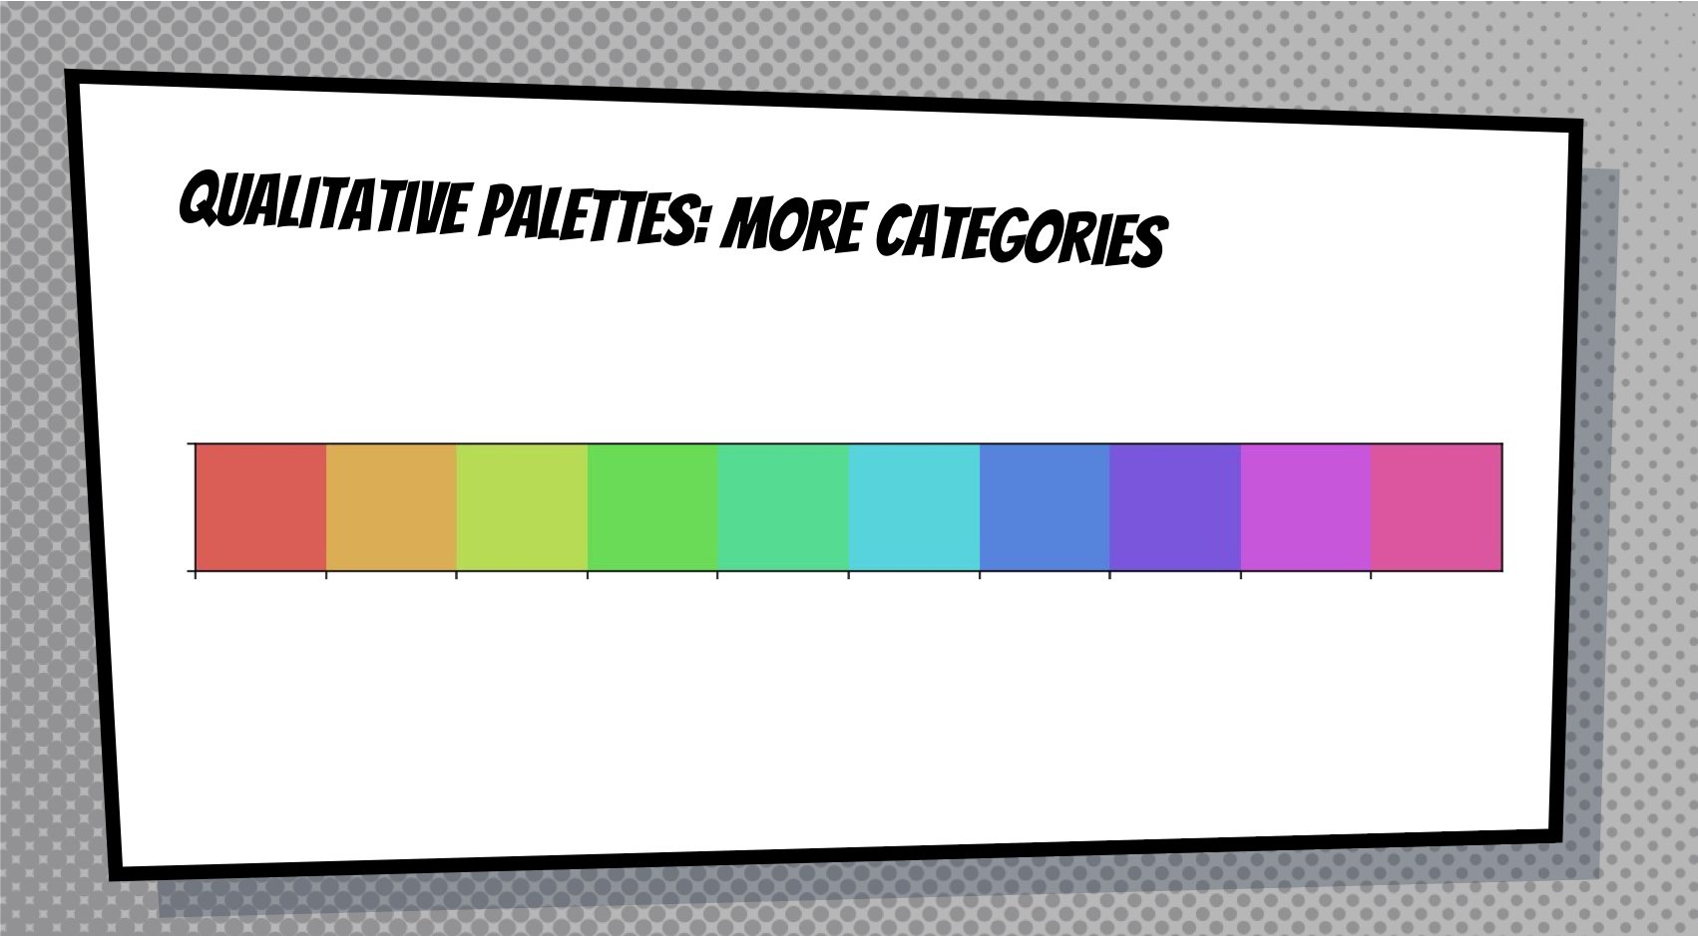

Slide 42
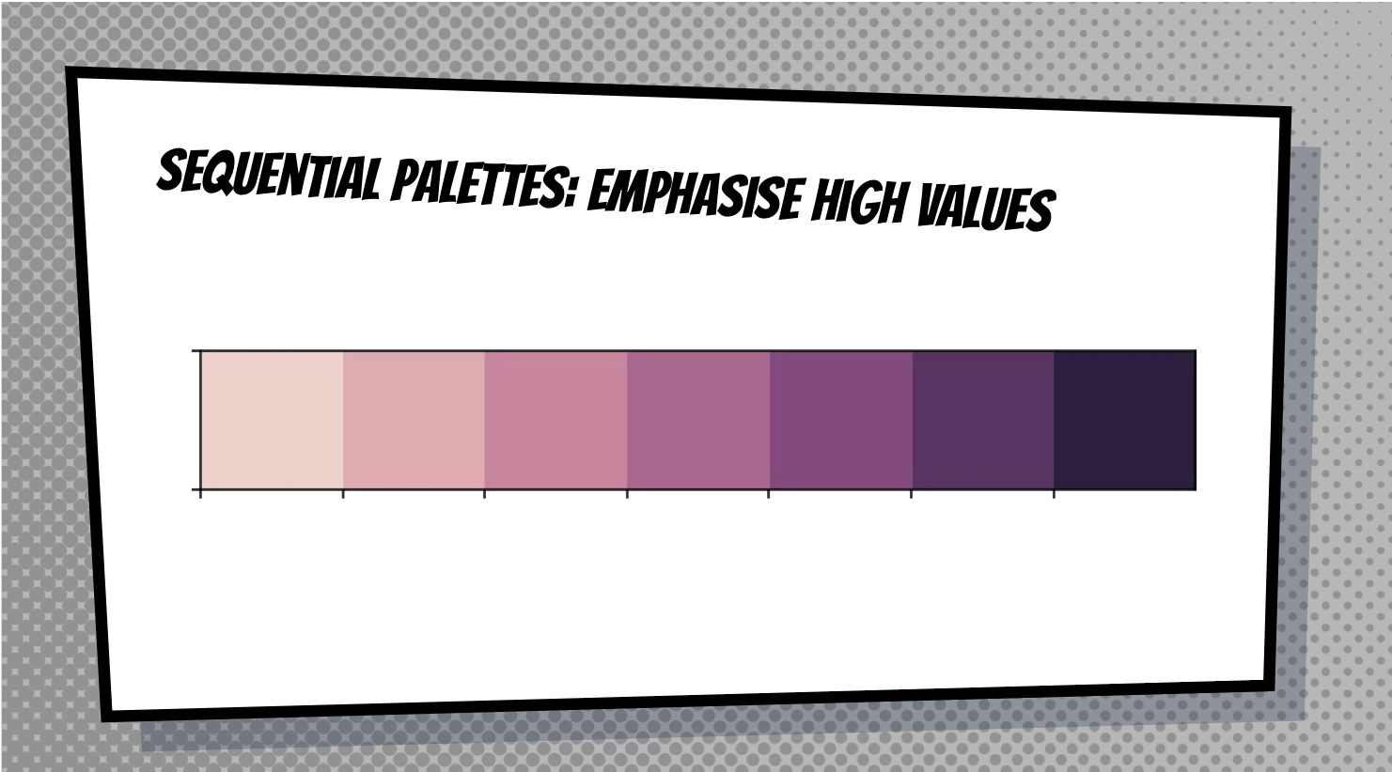

Slide 43
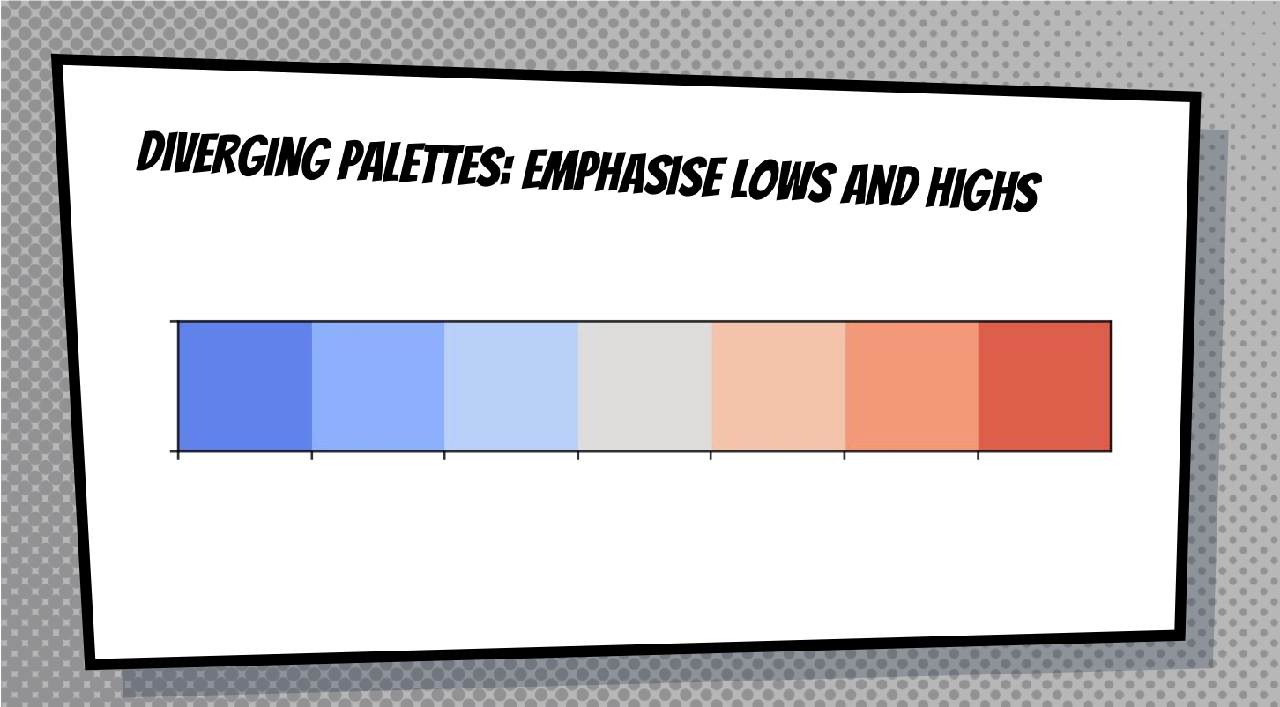

Slide 44
